Slide 1
Aris Theophilou | Giannis Kaoullas | Kyriakos Arnaoutis | Panayiotis Makris | Antonis Papadopoulos | Marios Charalambous
2014
NICOSIA-CYPRUS
Senate Council building "Leventis", University of Cyprus, New Campus
Saturday April 12 to Sunday April 13, 2014

Slide 2
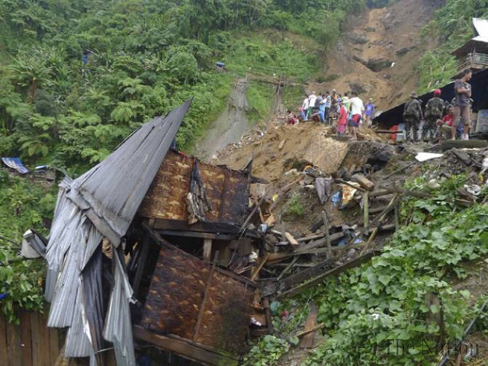
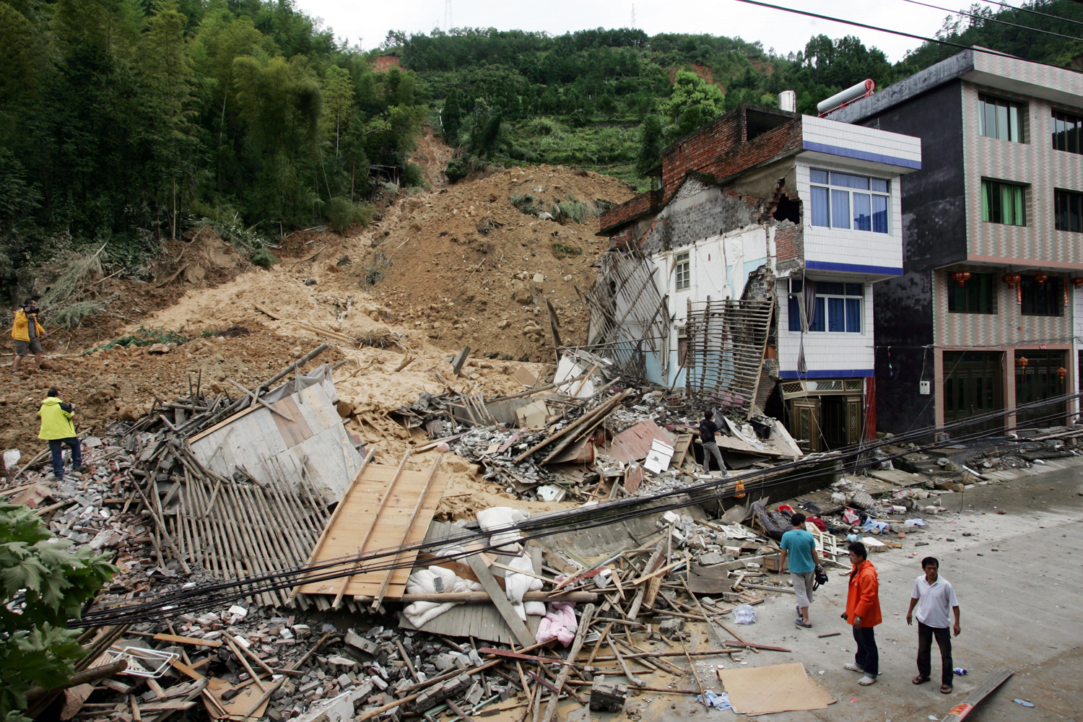
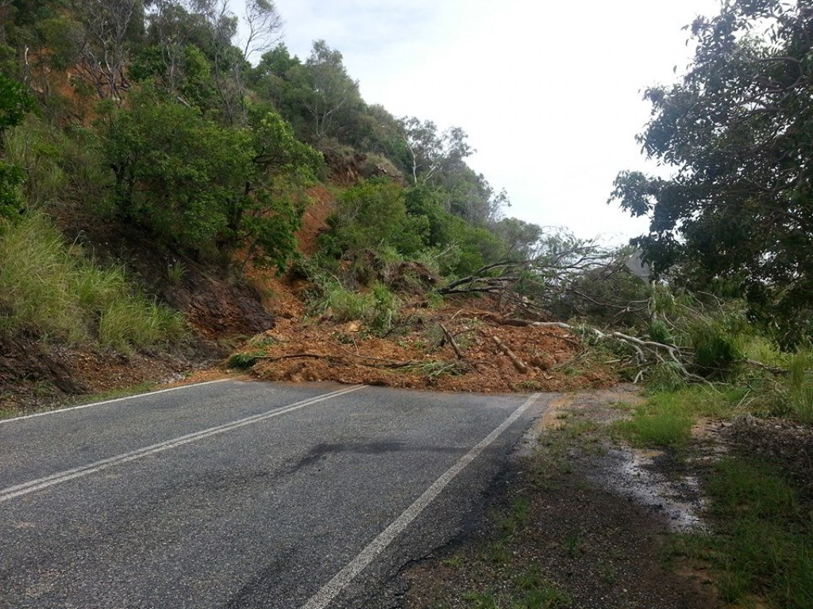
The Problem
Landslides occur due to the rise of the water level in the ground, usually after a prolonged rainfall.
They usually result in extensive monetary, material, and social losses.
For example, a recent landslide in Washington resulted in 33 casualties.

Slide 3
The Solution
Developed an Early Warning System (EWAS), that informs people about the likelihood of a landslide in a particular area.
The system sends color messages to people’s smartphones, informing them (1) that the area is safe (green), (2) there is a potential for a landslide (orange), and (3) the area should be immediately evacuated (red).

Slide 4
System Components
Measure devices for the water level in the ground (used fictitious data).
Central console to read the water level data in real-time.
Mathematical model that evaluates the potential of a landslide, termed “Factor of Safety”.
Website on which the Factor of Safety, together with the respective colour code are posted.
Smartphone application that reads the website data and displays the corresponding colour code.

Slide 5
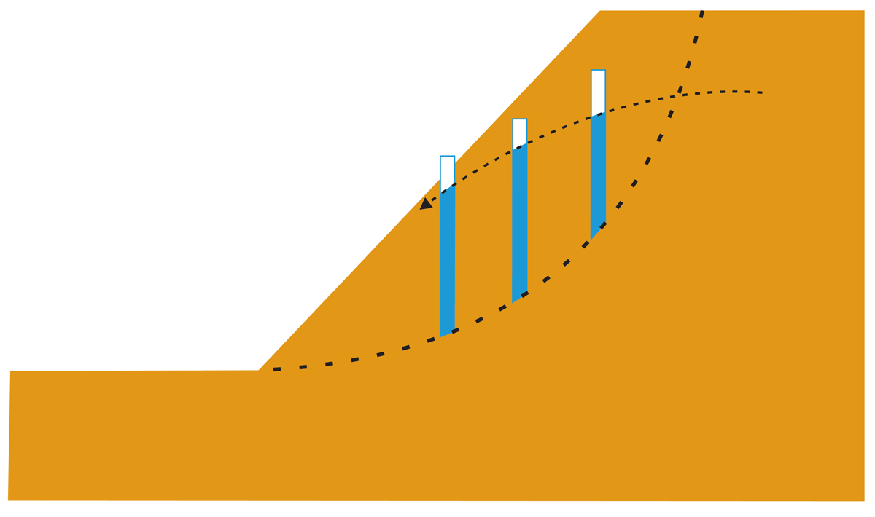
Mathematical Model
Slope Stability Evaluation using Bishop’s Method

Slide 6
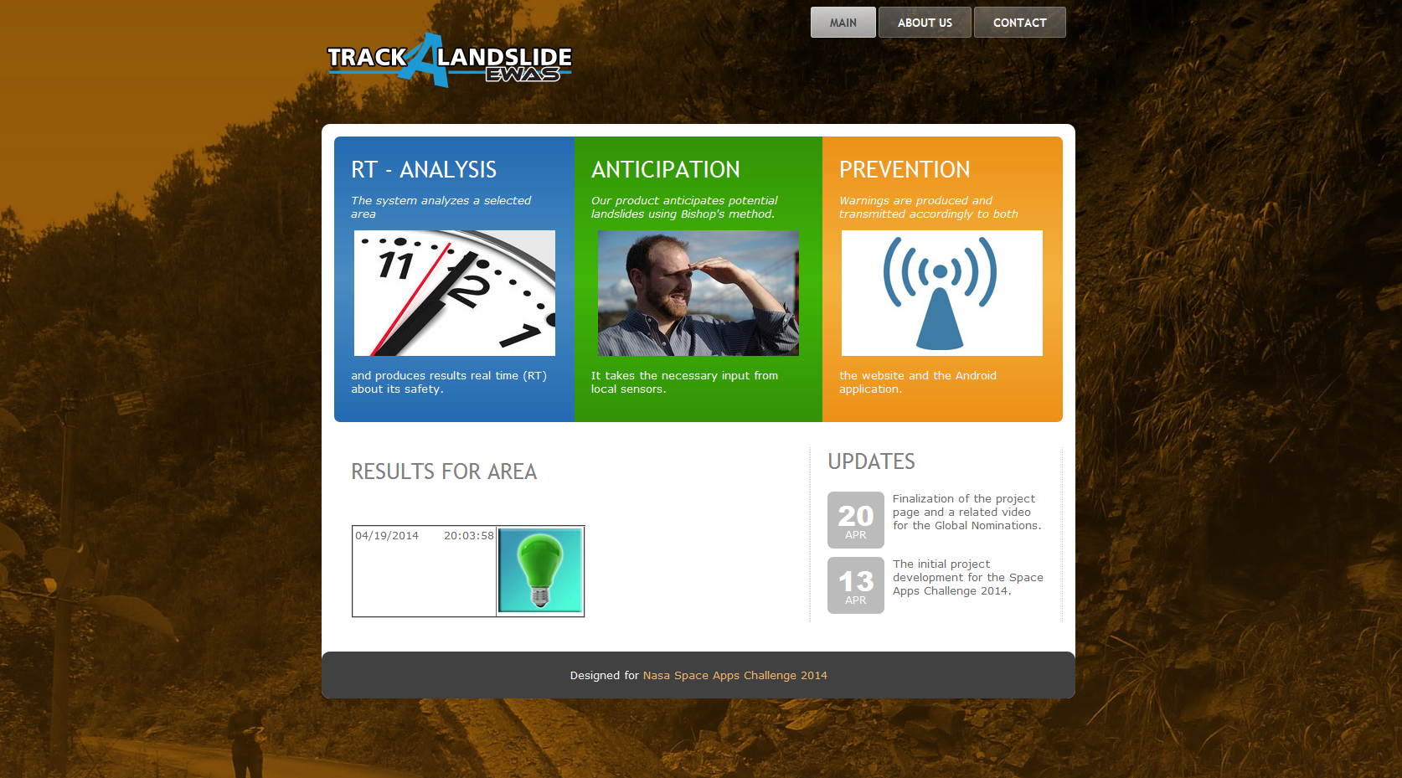
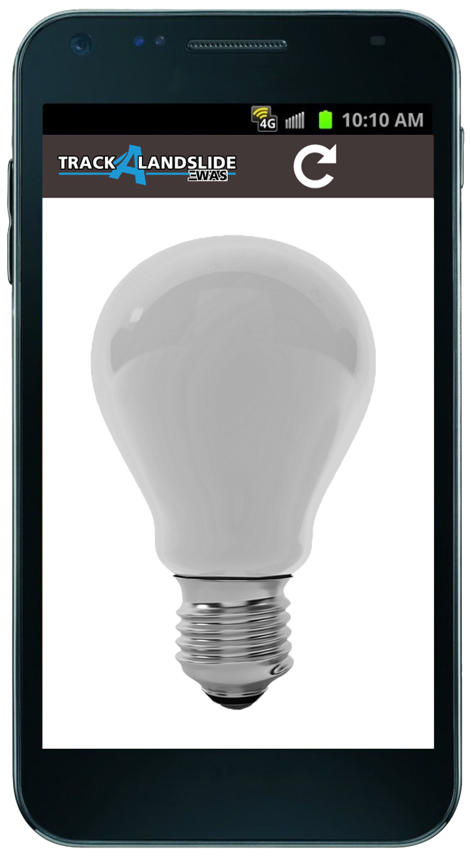
Website
Website displays the messages about the potential of a landslide.
Smartphone application can be downloaded.
INSTALL APP

Slide 7
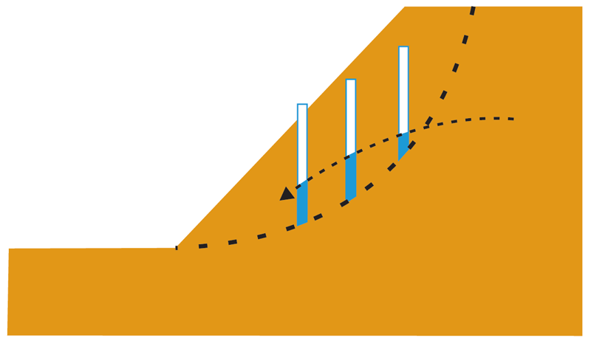
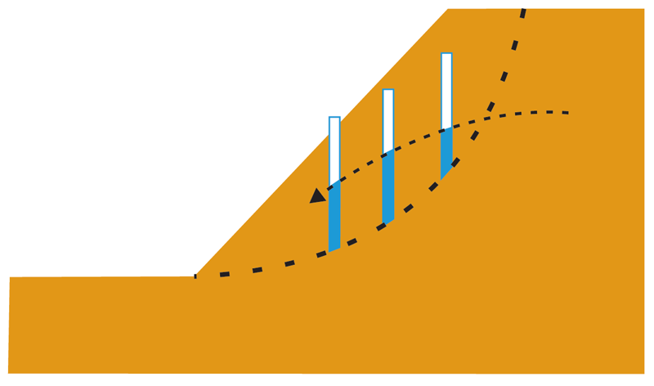


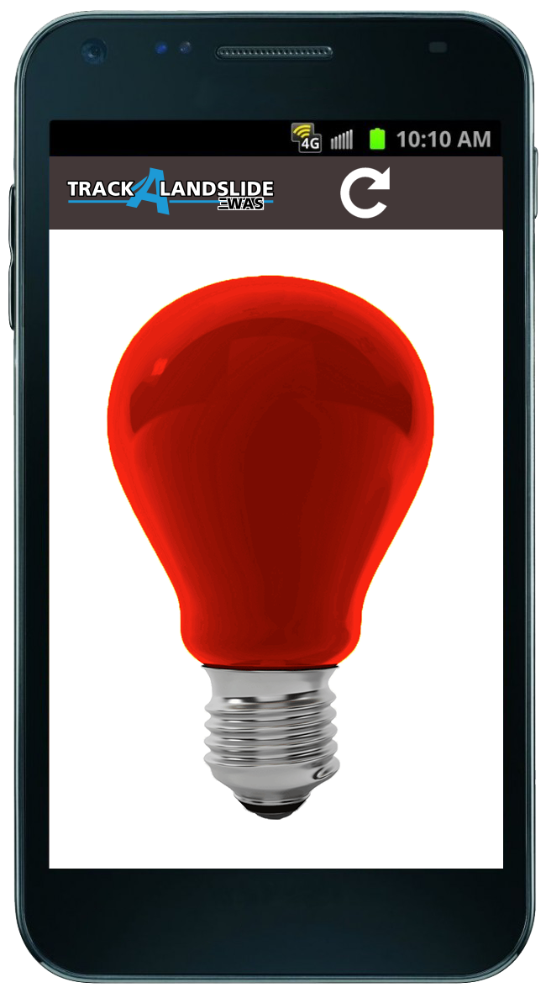
Smartphone Application
Smartphone application receives messages from the website about the potential of a landslide.
SAFE
WARNING
EVACUATE

Slide 8
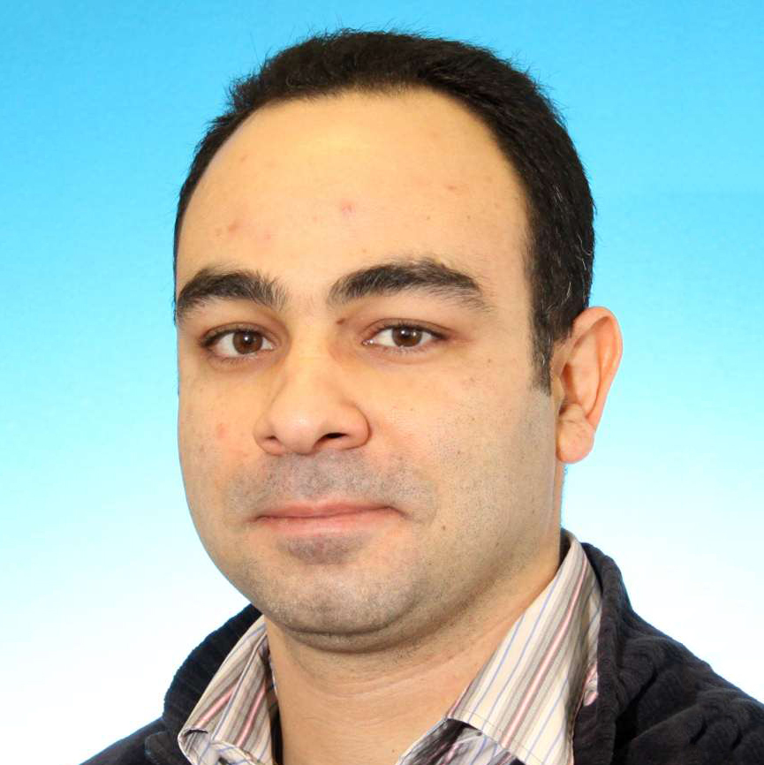



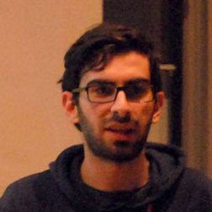
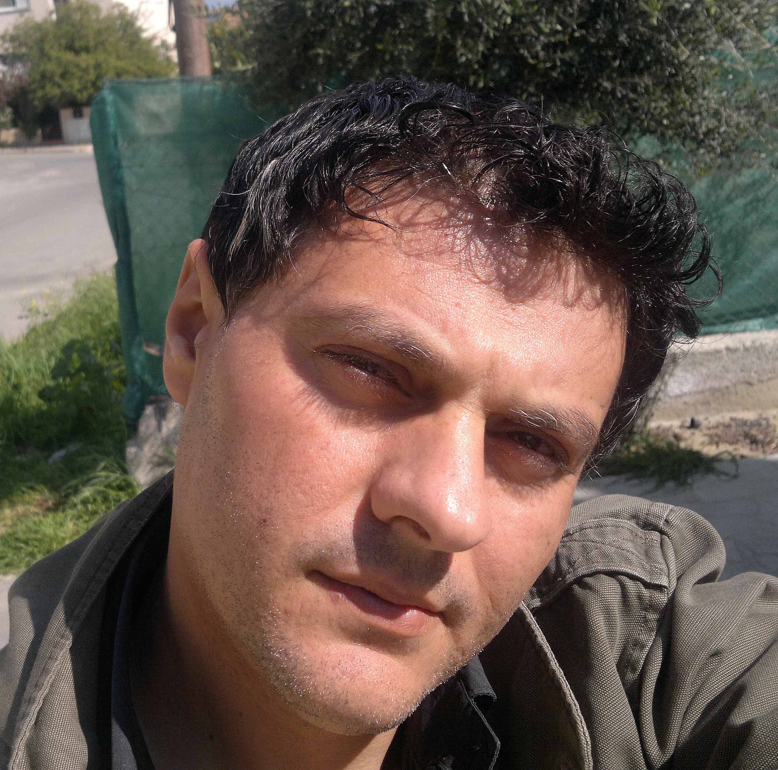
The Team
Project Leader
ARIS THEOFILOU
Inspirer of the idea. Responsible for the mathematical model behind this project.
Android Developer
GIANNIS KAOULLAS
Developer of the Android application
Website Developer
ANTONIOS PAPADOPOULOS
Developer of the website. The youngest member of the team
Developer
KYRIACOS ARNAOUTIS
Middleware developer, project manager, server administrator, helping web developing
Android Developer
PANAYIOTIS MAKRIS
Developer of the Android application
Graphic Designer
MARIOS CHARALAMBOUS
Creator of the application’s logo, the graphics of: the website, the Android application and the power point presentation

Slide 9
SPECIAL THANKS TO
FOR GIVING US THE OPPORTUNITY
TO CREATE
2014
NICOSIA-CYPRUS

